Slide 1
New DCC Training #1
Level 0 Basics and Fall SIrS Reporting Tasks

Slide 2
NYS Reporting
NYS Reporting is the mandated collection of student and staff data for analysis at the local, regional, and State levels to improved student performance and to meet State and federal reporting and accountability requirements.
Data collection is through the NYS Student Information Repository System (SIRS) which provides a single source of standardized individual student records.
Level 0
Level 1
Level 2
MAARS
WNYRIC Regional Data Warehouse
State Data Warehouse (L2RPT)

Slide 3
Who’s Who in NYS Reporting
NYSED: The Information and Reporting Services (IRS) department collects and reports data on public districts, charter schools, and participating nonpublic schools in NYS.
Regional Level 1 Data Center: WNYRIC is our hosted Level 1 Data Center.
Monroe RIC: M.A.A.R.S. provides services related to State accountability, testing and data reporting. We house Level 0. We are your liaisons to the IRS department.
District: The District Data Coordinator oversees the collection of district data and acts as a liaison to M.A.A.R.S.

Slide 4
SIRS Reporting Levels
L2
L2RPT
(State)
System for collecting student and staff data through a series of databases
L1
WNYRIC
(Regional)
Level 0
(Monroe)
Level 0 Historical
(State)
HR
SMS
ASAP/MAARS
Cafe
Sp. Ed.
Manual Entry
MAARS
District Source Systems

Slide 5
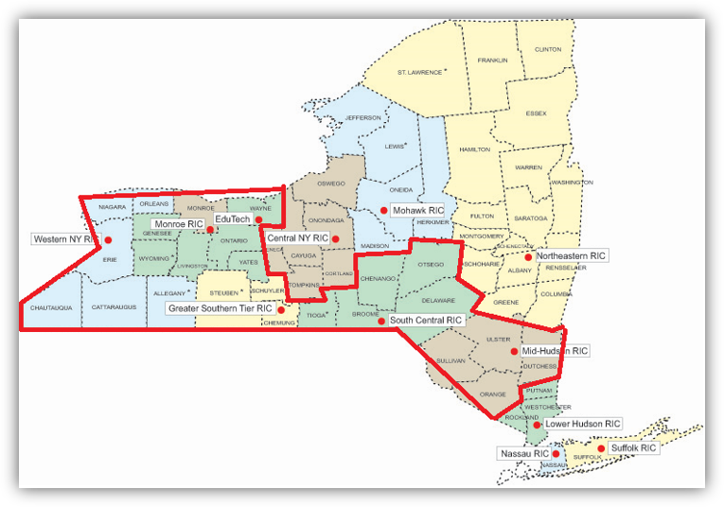
WNYRIC Data Warehouse - Level 1

Slide 6
Level 2 – State Data Warehouse
Level 2
L2RPT
ESSA
School Report Card
Federal Reporting
Federal and State Funding
PD System
(Pupils with Disabilities)
Systems populated by SIRS
How data from SIRS is used

Slide 7
What data is collected through SIRS?
Student Data
Staff Data
Demographic
Enrollment
Program Services
Assessments
Course
Grades
Attendance
Suspension
Behavioral Intervention
Student Digital Resources Survey
Partner Project Fact
Staff Snapshot
Staff Assignment
Teacher Assignment
Teacher Attendance
Teacher and Principal Tenure
Teacher and Principal Evaluation

Slide 8
District Data Sources
Student Data Sources
Staff Data Sources
Student Management System*
Frontline IEP
  Disability Program Service
  October Snapshot
  EOY Snapshot
  Sp. Ed. Events
  NYSAA Program Service
Frontline 504
  504 Program Service
Nutrikids or other POS Lunch System
  Free & Reduced Lunch Program Service
  Poverty Program Service
Staff Management System*
  Staff Snapshot
  Staff Assignment
  Staff Tenure
  Staff Attendance
Student Management System
  Course Instructor Assignment
3rd party vendors (Frontline or eDoctrina)
  Staff Evaluation
* Primary data sources

Slide 9
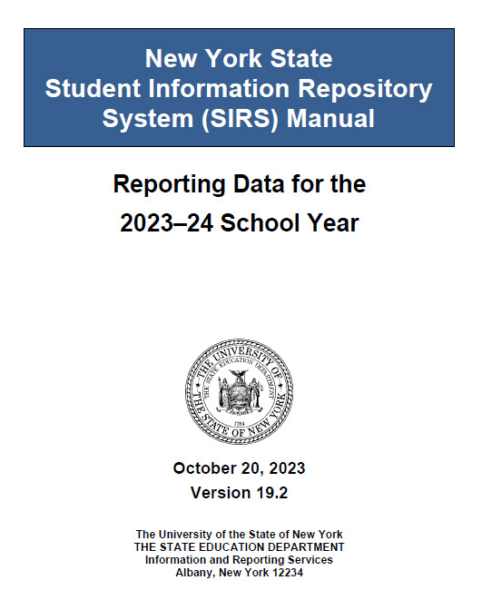

Data Reporting Resources
SIRS Manual: defines data elements and provides instruction on how data elements are reported https://www.p12.nysed.gov/irs/sirs/
SIRS Reporting Timeline: includes the deadlines for data verification and certification. https://www.nysed.gov/information-reporting-services
MAARS Team: help with questions about data reporting, Level 0, Level 1, and L2RPT.

Slide 10
SIRS Manual
The Big Book of State Reporting
  Be sure to download most current version
  Beware of printed pages
Most used sections
  Table of Reporting Responsibility
  Enrollment Codes and Descriptions
  Staff Reporting Rules
  Program Service Codes and Descriptions

Slide 11
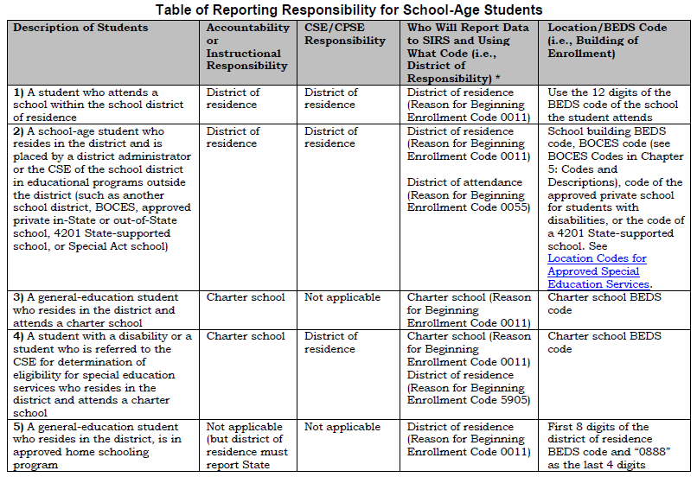
Table of Reporting Responsibility
Describes how to enroll students based on common scenarios
  Accountability Responsibility –responsible for performance (School Report Card)​
  Instructional Responsibility –responsible for providing instruction​
  CSE/CPSE Responsibility –responsible for the Special Education services​
  District of Residence – ​
  the district in which the student lives​
  District of Attendance – ​
  the district the student attends

Slide 12
Enrollment Codes and Descriptions
Common Enrollment Beginning Codes
Common Enrollment Ending Codes
  0011 – Enrollment in building or grade
  5905 – CSE/CPSE Responsibility Only
  4034 – Preschool-age students enrolled for determining eligibility for special education services
  170 - Transferred to another NYS public school outside this district with documentation
    NOTE: Charter schools are public schools
  204 – Transferred to a NYS Religious and Independent School with documentation
  221 – Transferred to a school outside of NYS with documentation
  153 – Transferred to another school in this district or to an out of district placement
  442 – Left the U.S.
  799 – Graduated (earned Regents or local diploma)

Slide 13
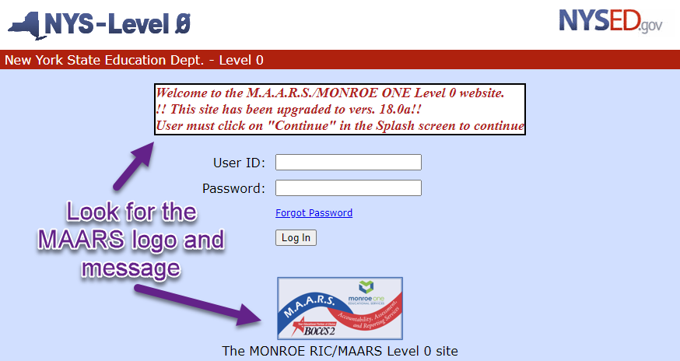
Level 0 - https://level0.monroe.edu

Slide 14
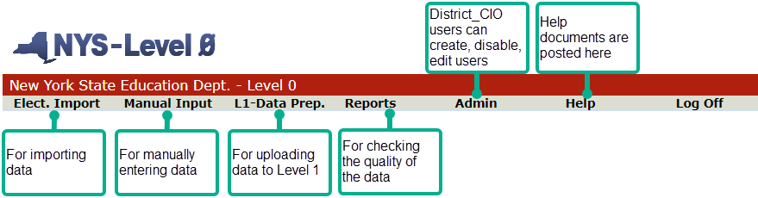
Level 0 Top Navigation Menu

Slide 15
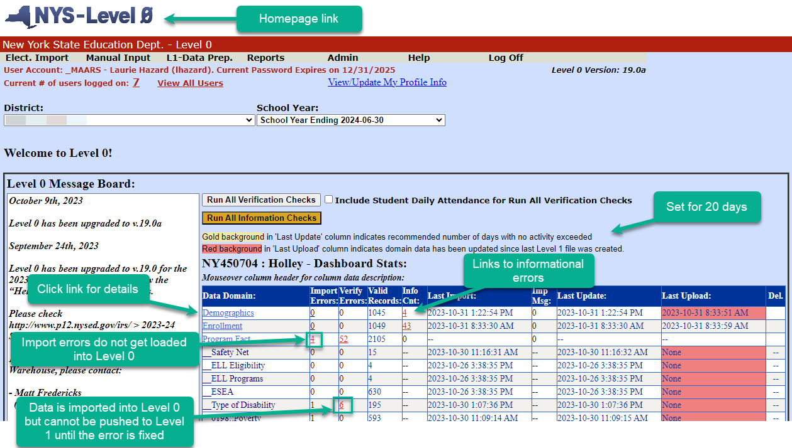
Level 0 Dashboard

Slide 16
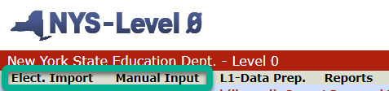
Entering Data into Level 0
2 ways to enter data
  Elect. Import
    .csv file or .txt file
    Must match escholar templates https://www.p12.nysed.gov/irs/vendors/home.html
    Export from SMS or other system
  Manual Input
    Hand enter data directly into Level 0
Data dependencies dictate in what order to enter data

Slide 17
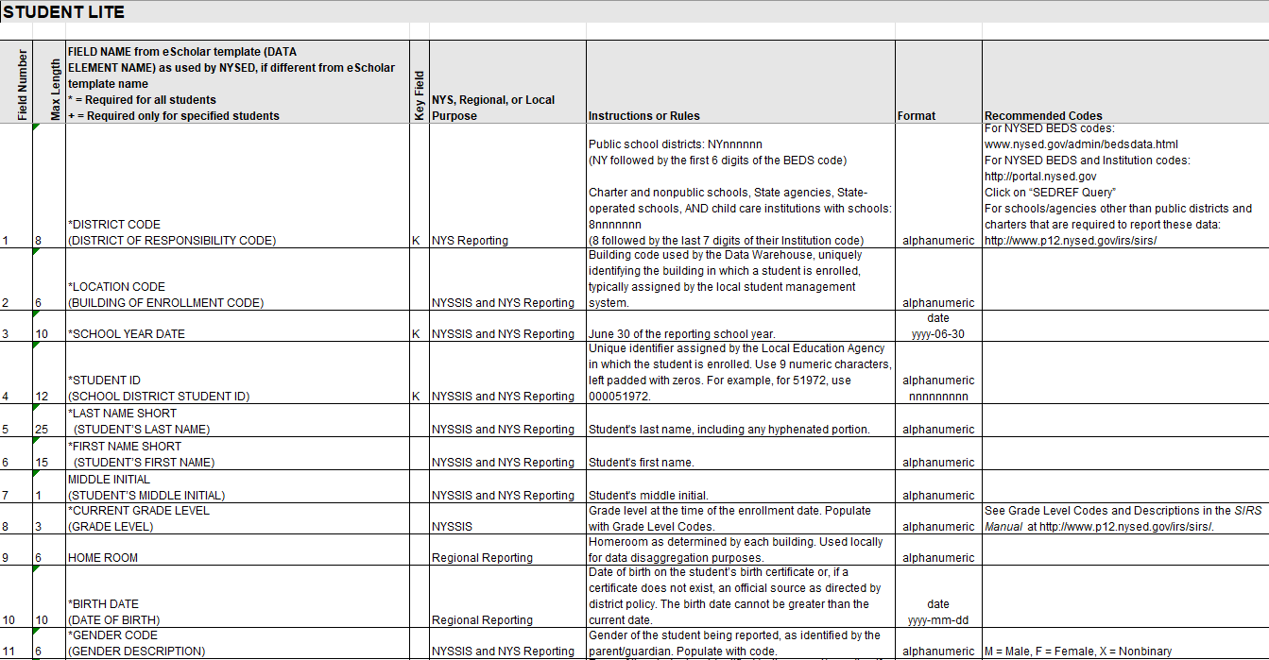

Slide 18
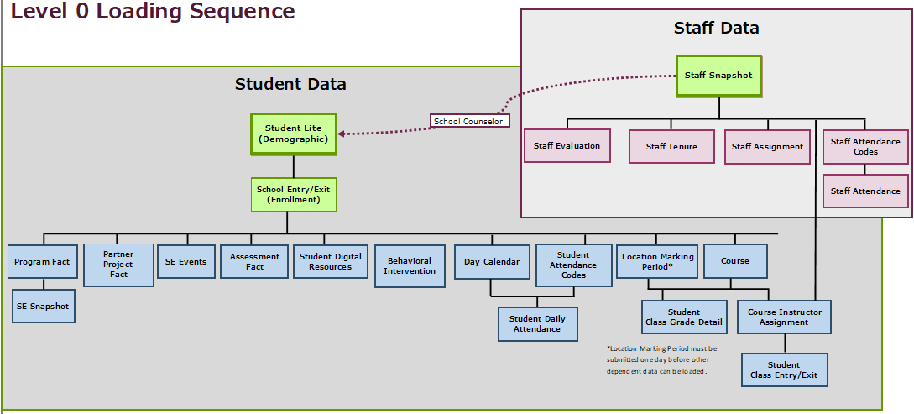

Slide 19
Student Data in SIRS​
Student Data​ | Level 0​ | SIRS Template​ | Data Source​ | SIRS Manual​
Who am I?​ | Demographics​ | Student Lite​ | SMS​ | Chapter 2:​ District of Residence Codes​ Graduates​ Career Pathways​ Chapter 5:​ District of Residence Codes​ Career Path Codes Credential Type Codes ​
Where am I?​ | Enrollments​ | School Entry/Exit​ | SMS​ | Chapter 2:​ Table of Reporting Responsibility​ Walk-in Enrollments​ Chapter 5:​ Enrollment (Beginning and Ending) Codes and Descriptions​
What Program Services do I participate in?​ | Program Fact​ | Programs Fact​ | SMS​ Food Service System​ Frontline IEP & 504​ | Chapter 5:​ Program Service Codes and Descriptions​
What assessments have I taken?​ | Assessment​ | Assessment Fact​ | SMS, College Board, IB​ (MAARS loads 3-8 ELA/Math, Gr. 4 & 8 Science, Regents)​ | Chapter 5:​ Assessment Measure Standard Codes and Descriptions​
What classes have I taken?​ | Course​ Stu/Class/Entry/Exit​ Course/Instr/Assign​ Location M.P.​ | Course​ Student Class Entry/Exit​ Course Instructor Assignment​ Location Marking Period​ | SMS​ | Chapter 3:​ Course Instructor Assignment​ Student Class Entry/Exit​
What grades did I earn?​ | Stu/Class/Gr/Detail​ | Student Class Grade Detail​ | SMS​ | Chapter 3:​ Student Class Grade Detail​
What school days have I been present or absent?​ | Stu/Attend/Codes​ Stu/Daily/Attend​ Day Calendar​ | Student Daily Attendance​ Day Calendar​ | SMS​ | Chapter 5:​ Student Attendance Codes and Descriptions​
What is my access to technology at home?​ | Student Digital Resources​ | Student Digital Resources​ | SMS??​ | Chapter 2:​ Student Digital Equity (Resources)​

Slide 20
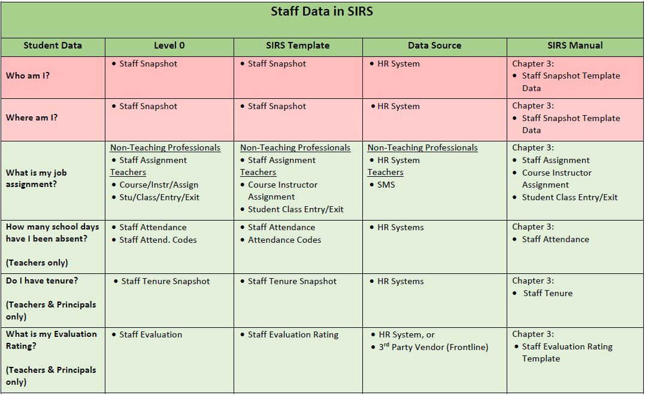

Slide 21
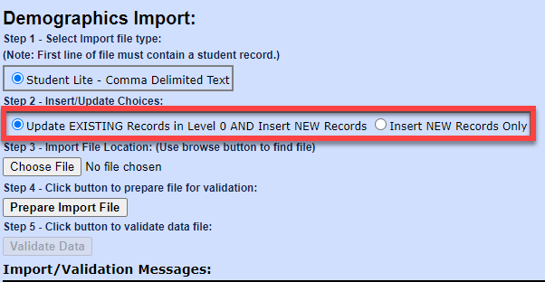
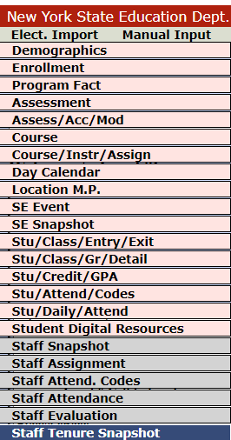
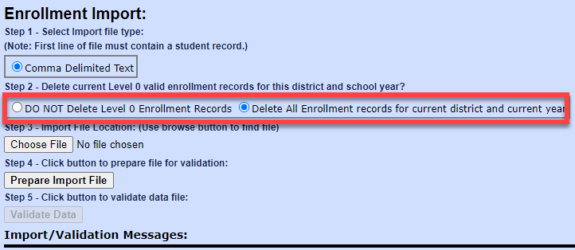
Electronic Import

Slide 22
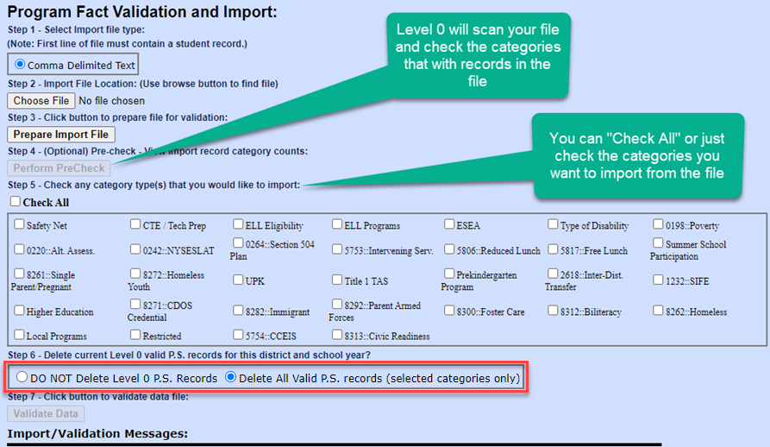
Importing Program Fact
Deleting ALL records in a Program Service Category
Import your Program Fact records
Perform the PreCheck
Select the category where all records need to be deleted
Contact Laurie Hazard or Matt Fredericks so they can tell Level 1 to delete the records for that category, too

Slide 23
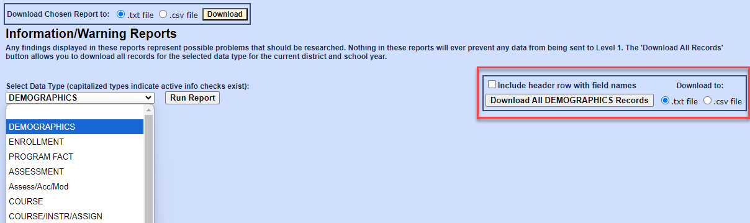
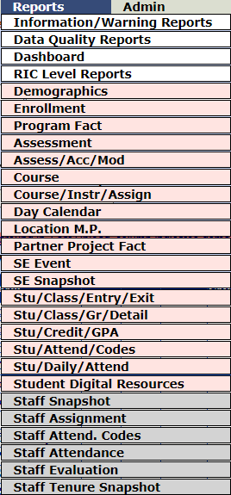
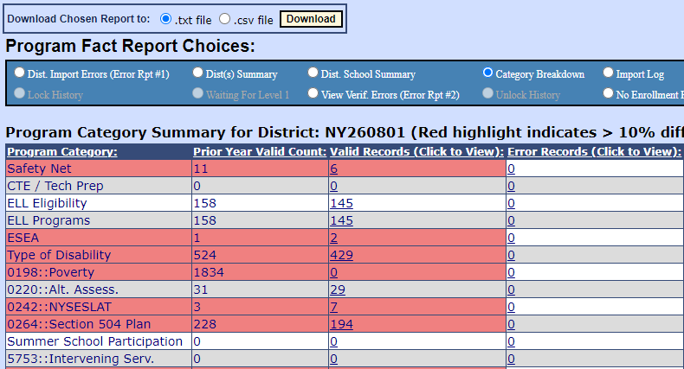
Reports

Slide 24
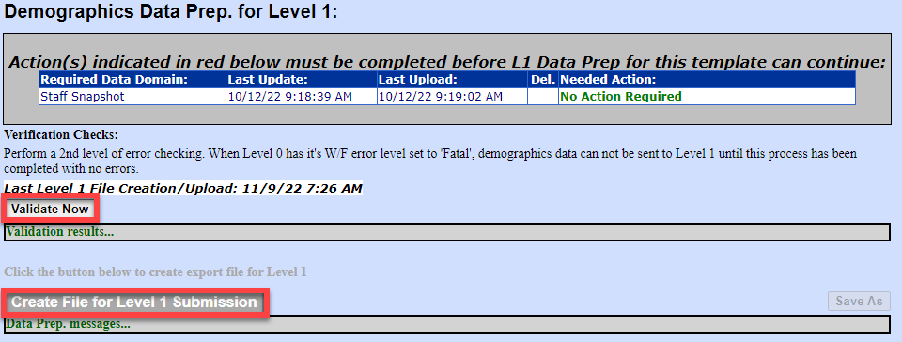
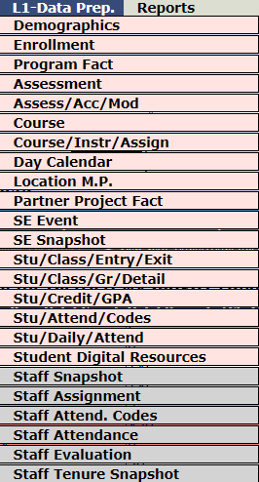
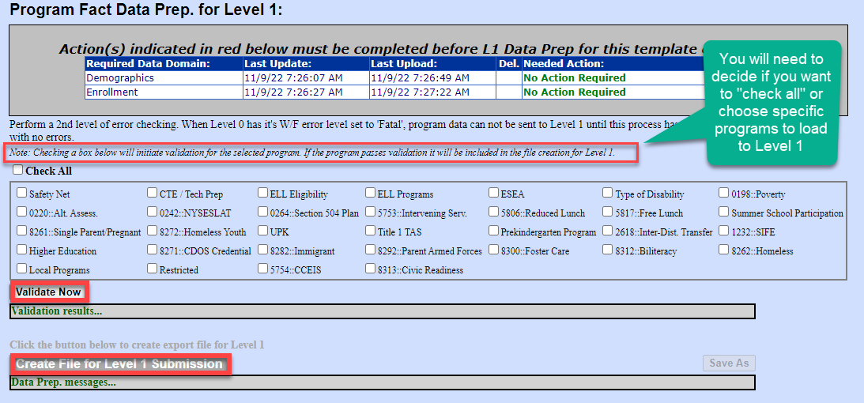
L1-Data Prep
1
2
3

Slide 25
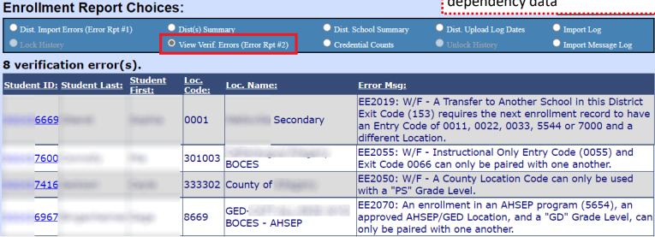
Level 0 Errors
Verification Errors
  Warning/Fatal (W/F) errors
  Result from a mismatch in dependency data

Slide 26
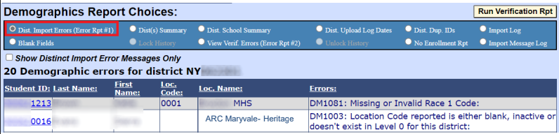
Level 0 Errors
Import Errors
  Relate to required missing or invalid data
  Data does not get loaded into Level 0

Slide 27
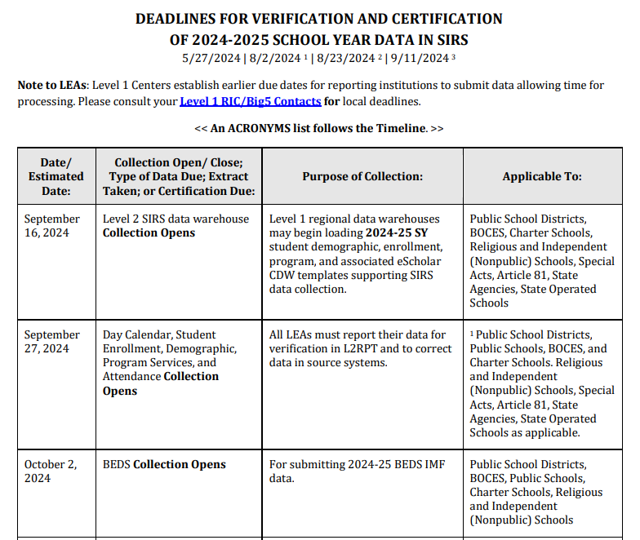
SIRS Timeline & Fall Tasks
The SIRS Timeline is posted under Quick Links on the IRS website:
https://www.nysed.gov/information-reporting-services
MAARS dues dates are always the day before on Thursday by noon
Work backwards from due dates
  If data is due Thursday, 1/25…
  Then plan to have your data loaded 2 weeks before on Thursday, 1/11
  Plan to verified L2RPT reports on Monday 1/15 so that you can make corrections by Thursday, 1/18
  This will leave you one last week for final corrections

Slide 28
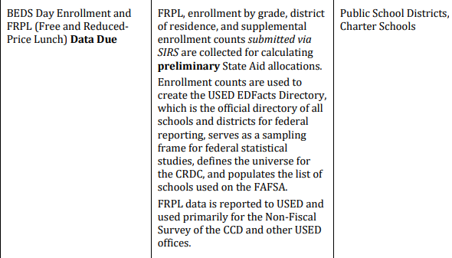
BEDS Day Collection (Public & Charters only)
Student enrolled on first Wednesday of October
Demographics (Student Lite)
  District of Residence Code
Enrollments (School Entry/Exit)
Programs
  Free (5817) & Reduced (5806) Lunch
  Poverty (0198)
  PreKindergarten: UPK (902) and Other (990)
Data due Thursday, January 2

Slide 29
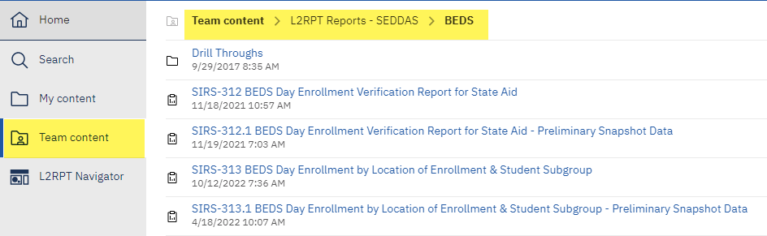
L2RPT BEDS Reports
Snapshot Dates
January 3, 2024
March 14, 2024
August 15, 2024

Slide 30
PD Reporting: October Snapshot
Demographics (Student Lite)
Enrollments (School Entry/Exit)
Programs
  Type of Disability
  NYSAA Eligible – due Tuesday, November 5
SE Snapshot
  October Snapshot or BEDS Day Snapshot
  Data due Thursday, January 16
  Certification due Tuesday, January 21
Look for info about PD Reporting training on 10/31 in the MAARS Weekly Digest!

Slide 31
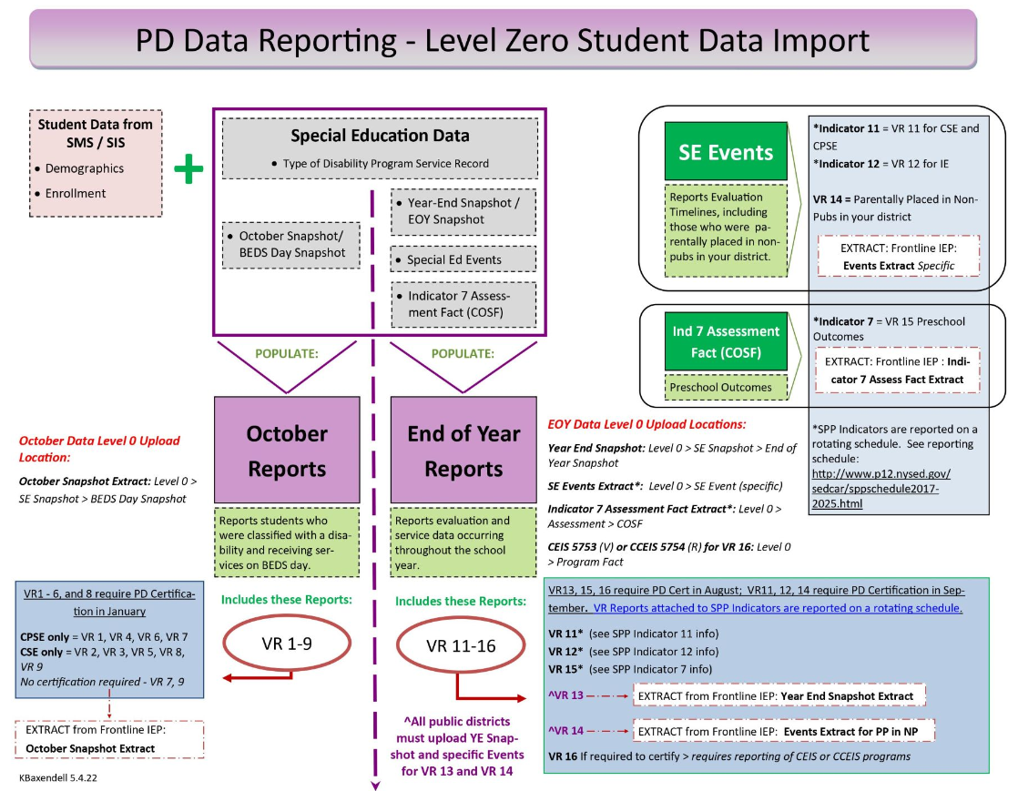
Overview of PD Snapshots
https://www.monroe2boces.org/Downloads/PD%20Reporting%20Level%200%20Flow%20Updated%20%20KB.jpg

Slide 32
Summer School Program Services
Students who attended a summer school program to
  Earn credit for a course
    New
    Credit recovery
  Regents Review Class
  Elementary students in a summer AIS-type class
NOT ESY
Data due Thursday, August 14
Program | Reason
 | A |  | B
English Language Arts | 2751 |  | 2861
Mathematics | 2752 |  | 2862
Science | 2753 |  | 2863
Social Studies | 2754 |  | 2864
Technology | 2755 |  | 2865
The Arts | 2756 |  | 2866
Languages Other Than English | 2757 |  | 2867
Health | 2758 |  | 2868
Physical education | 2759 |  | 2869
Driver Education | 2760 |  | 2870
Other | 2761 |  | 2871

Slide 33
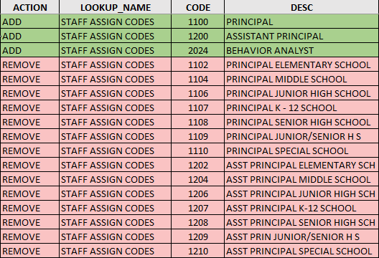
Staff Data (Districts, BOCES, & Charters)
Staff Snapshot
Staff Assignment
  Staff Assignment Codes & Descriptions - Page 181
  Principal – 1100
  Assistant Principal – 1200
  Behavior Analyst – 2024
  Use grade level “ALL” unless staff is a principal who is only responsible for some grades
Data due Thursday, November 14

Slide 34
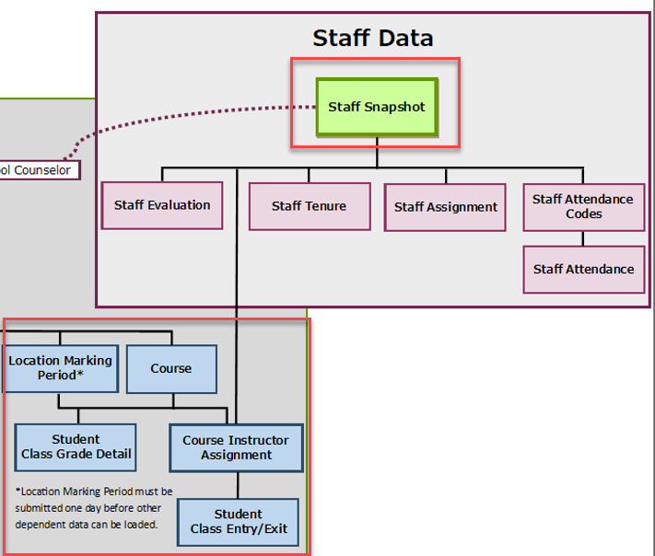
CIA/SCEE (Districts, BOCES, & Charters)
Course Instructor Assignment
  Connects teachers to courses
Student Class Entry/Exit
  Connects students to teachers
Must have Staff Snapshot loaded in Level 0 before you can load CIA
Preliminary data due Thursday, January 23
Final data due Thursday, May 15

Slide 35
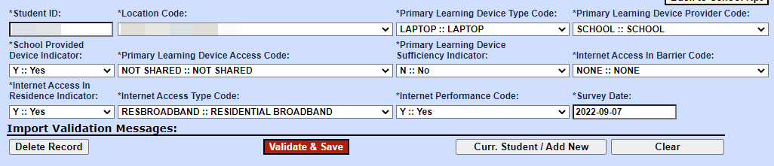
Student Digital Resources (District, BOCES, & Charters)
Annual and ongoing collection
A survey seeking to learn more about student access to technology at home
Survey is for parents/guardians, but you can survey students as well
Data due Thursday, January 23

Slide 36
NYSESLAT Pre-ID Data
Must report all 0231 - ELL Eligible and ELL Programs
ELL Eligible data is used by NYSED to identify students who need to take the NYSESLAT exam
If your data isn’t in L2RPT then you will not get pre-printed labels for your NYSESLAT answer sheets
Data is due Thursday, February ??

Slide 37
Monthly Data Updates
Update Level 0 Data Monthly
Pay attention to MAARS Weekly Digest
  3-8 CBT & PBT data deadlines
  Regents data deadlines
Level 0 Training Video: https://www.monroe2boces.org/protected/SecuredAccess.aspx?redirect=RecordedWebinarsTrainings.aspx
  Password: data

Slide 38
Questions?

